Slide 1
Proportion Problems including money problems
J.Wilson

Slide 2
Exchange rates are used to work out how much something is worth in another currency.
Example $1 Aus : $1.08 NZ means that something that cost $1 in Australia costs $1.08 in NZ. These are proportionate. So how much would a watch cost in New Zealand if it is $23 in Australian dollars.
Aus NZ

Slide 3
Exchange rates are used to work out how much something is worth in another currency.
Example $1 Aus : $1.08 NZ means that something that cost $1 in Australia costs $1.08 in NZ. These are proportionate. So how much would a watch cost in New Zealand if it is $23 in Australian dollars.
Aus NZ $1 costs $1.08 $23 costs $ x

Slide 4
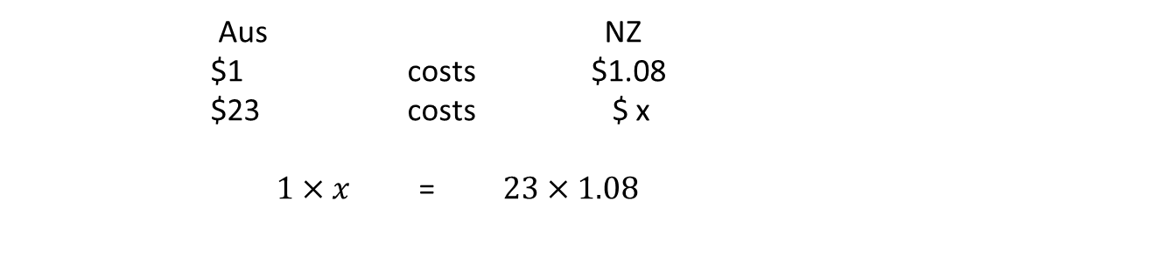
Exchange rates are used to work out how much something is worth in another currency.
Example $1 Aus : $1.08 NZ means that something that cost $1 in Australia costs $1.08 in NZ. These are proportionate. So how much would a watch cost in New Zealand if it is $23 in Australian dollars.
Aus NZ $1 costs $1.08 $23 costs $ x $1×x$ = $23×1.08$

Slide 5
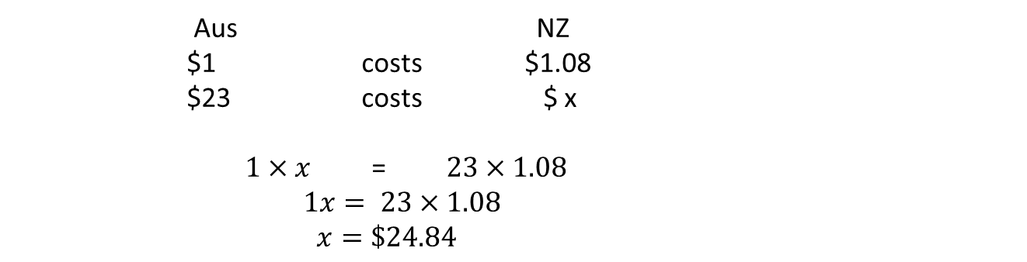
Exchange rates are used to work out how much something is worth in another currency.
Example $1 Aus : $1.08 NZ means that something that cost $1 in Australia costs $1.08 in NZ. These are proportionate. So how much would a watch cost in New Zealand if it is $23 in Australian dollars.
Aus NZ $1 costs $1.08 $23 costs $ x $1×x$ = $23×1.08$ $1x= 23×1.08$ $x=\$24.84$

Slide 6

Exchange rates are used to work out how much something is worth in another currency.
Example $1 Aus : $1.08 NZ means that something that cost $1 in Australia costs $1.08 in NZ. These are proportionate. So how much would a watch cost in New Zealand if it is $23 in Australian dollars.
$x=\$24.84$
Now we know 1 watch costs $24.84, how many watches can I get for $170 NZ?
1:$24.84 x:$170
watches $
1 costs $24.84
x costs $170
$1 ×170$ = $24.84×x$ $170=24.84x$ Divide both sides by $24.84 170 ÷ 24.84 $=$ $x$
6.84 = x therefore I can buy 6 watches

Slide 7
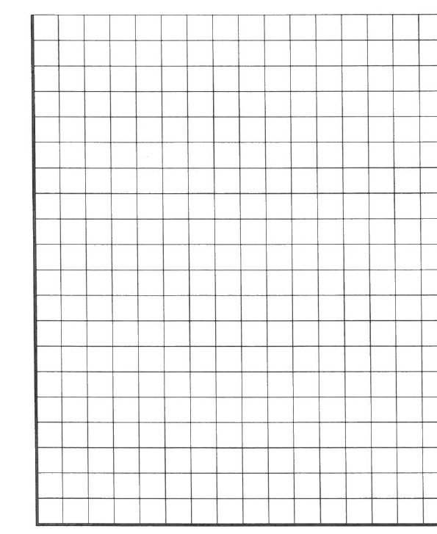

If the price of steak is $32 per kilogram, how much would 500g cost?
$32:1Kg = x :500g $32:1Kg = x : 0.5kg
Begin by converting these into the same units.
We can also solve using a graph.
Since it is proportional, we know it must form a straight line that goes through the origin.
$ Kg
32 : 1
x : 0.5
$32 ×0.5$= $x×1$ $16=1x$ $\$16=x$
$
34
32
30
28
26
24
22
20
18
16
14
12
10
8
6
4
2
0
0.5 1 Kg

Slide 8

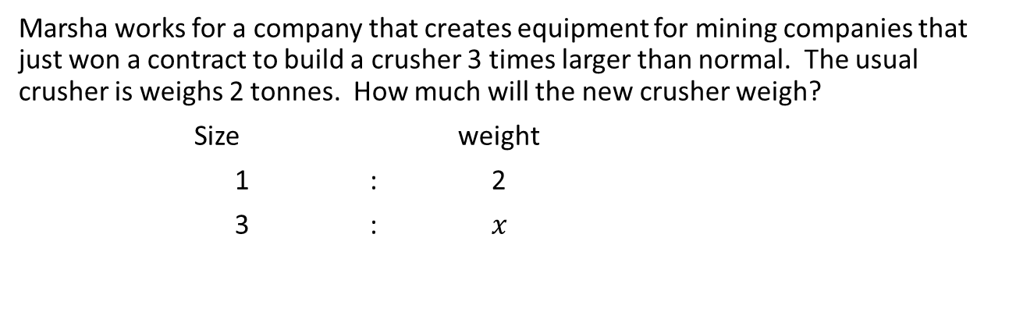
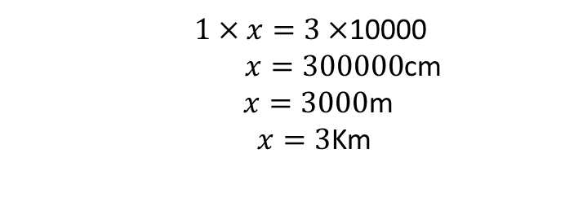
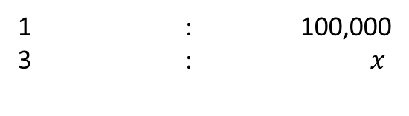
Marsha works for a company that creates equipment for mining companies that just won a contract to build a crusher 3 times larger than normal. The usual crusher is weighs 2 tonnes. How much will the new crusher weigh?
Size weight
1 : 2
3 : $x$
$$1×x=2×3$$
$x=6$ tonnes
Robbie is using a map to calculate distances. The distance between 2 places on the map is 3cm and the scale on the map is 1:100,000. How far apart are the two places really?
Map World
1 : 100,000
3 : $x$
$1×x=3×$10000
$x=300000$cm
$x=3000$m
$x=3$Km

Slide 9
Topic : Proportion Problems
24
7
30
Date
EQ : What are some of the problems we can solve with proportion?
Proportion can be used to solve a number of problems that involve money. It can also be used to solve problems of scale.
We can use a graph or cross multiplication to help us solve these.

Slide 10
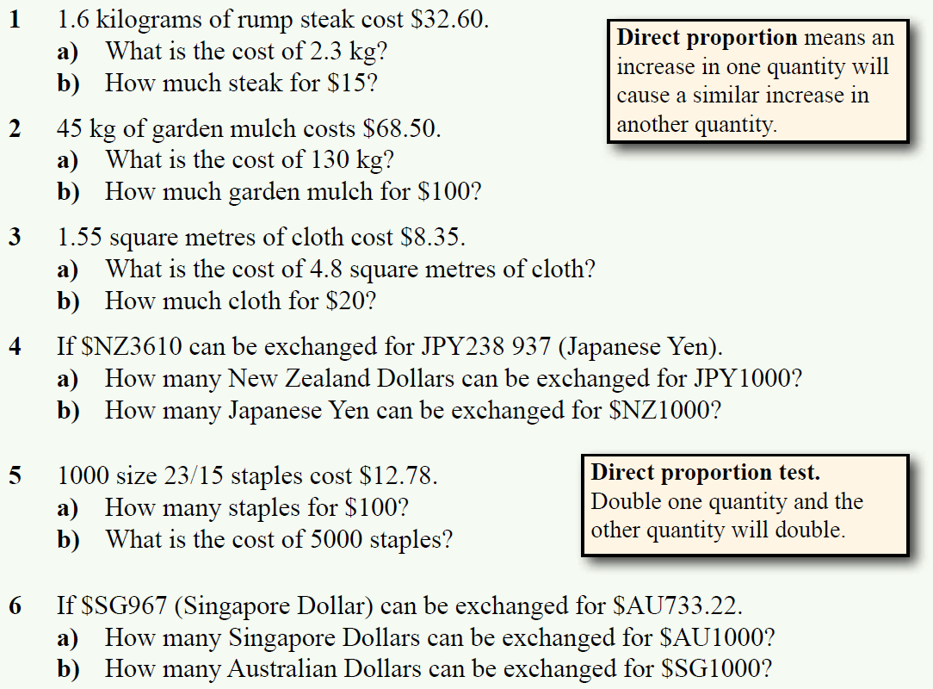
Complete Exercise 6.9 on page 81

Slide 11
Answers to Ex 6.9

